Slide 1
To Develop a Device Driver for UART using LPC2148
GUIDE : Prof. Ashwini Desai
NAME | USN | ROLL NO
ALLENA MULA | 02FE21BEC006 | 05
BASAVESH PATIL | 02FE21BEC018 | 15
HARSH A PATIL | 02FE21BEC035 | 32
PRATIK PATIL | 02FE21BEC063 | 58

Slide 2
Need analysis and identifying the problem
Need analysis:
Building a device driver for UART using the LPC2148 microcontroller is essential for enabling reliable and efficient communication between the microcontroller and other peripherals or devices. It allows for proper data transmission and reception over serial interfaces, crucial for debugging, and interfacing with various modules like Bluetooth, and sensors. A custom driver also ensures optimal performance tailored to specific application requirements, leveraging the hardware features of the LPC2148.
Identifying the problem:
The main challenge in building a device driver for UART using the LPC2148 microcontroller involves managing the intricacies of hardware configuration and ensuring reliable data transfer. This includes setting up baud rates, handling interrupts efficiently, and dealing with potential issues like data framing errors, and ensuring proper synchronization between the microcontroller and connected devices.

Slide 3
Professional ethics copy right, plagiarism.
Professional Ethics:
1. Transparency and Honesty: Clearly communicate the capabilities and limitations of the device driver. Ensure accurate reporting of bugs and issues.
2. Accountability: Take responsibility for your code and its impacts, ensuring it doesn't cause harm or malfunction in critical systems.
3. Privacy and Security: Safeguard any user data handled by the driver, implementing measures to prevent unauthorized access or data breaches.
Copyright:
1. Respect for Intellectual Property: Do not use proprietary code or documentation without permission. Ensure any third-party code is licensed for use and properly attributed.
2. Licensing Compliance: Follow the terms and conditions of open-source licenses or commercial software licenses for any incorporated code.
Plagiarism:
1. Originality in Development: Write your own code and documentation, ensuring that all content is your original work or properly credited if derived from other sources.
2. Proper Citation: When referencing existing works, provide appropriate citations and acknowledgments to avoid misrepresenting someone else's work as your own.

Slide 4
Problem definition
The problem involves developing a reliable and efficient device driver for the UART module of the LPC2148 microcontroller to facilitate robust serial communication. This driver must handle various configurations such as baud rate settings, data framing, and interrupt management while ensuring data integrity and minimal latency. The driver should be designed to support seamless integration with diverse peripheral devices and applications, addressing potential issues like buffer overflows and synchronization errors.

Slide 5
Application in societal context
Developing a device driver for UART using the LPC2148 microcontroller has several applications in a societal context, including:
Healthcare.
Automation and Control Systems.
Telecommunications.
Transportation.
Education and Research.

Slide 6
Gnat chart

Slide 7
Work break structure
1. Project Initiation:
Scope: The scope of developing a device driver for UART using LPC2148 involves initializing UART hardware, configuring baud rate, data format, enabling interrupts, and implementing send/receive functions.
Objectives: The objective is to facilitate efficient and reliable serial communication between the microcontroller and other devices by abstracting hardware complexities and providing a simple interface for data transmission and reception.
2. Planning Phase:
Initially we started with the learning of basics of device driver, UART and datasheet of 2148.
In 3rd phase the implementation and execution of the code.
At the end final demonstration and presentation of the required output.

Slide 8
3. Training and Execution:
Developing a device driver for UART using LPC2148 involves understanding the LPC2148 UART hardware specifications and registers, coding initialization and communication functions, and testing the driver with various serial communication scenarios.
4. User acceptance testing:
Conduct a survey to test for the required output.
Gather feedback and make the necessary changes.
5. Final closure:
Final implementation, demonstration and analysis of the required result.

Slide 9
Specification
1. Input Specifications:
- Baud rate settings (e.g., 9600, 19200).
- Data frame format (e.g., 8 data bits, 1 stop bit, no parity).
- UART control signals (e.g., RTS, CTS).
- Interrupt configuration for transmit and receive events.
2. Output Specifications:
- Transmit data buffer for sending data.
- Receive data buffer for storing incoming data.
- Status indicators (e.g., transmission complete, data available).
- Error detection and reporting (e.g., overrun, framing errors).

Slide 10
Identification
1. Input Identifications:
- Baud Rate Settings: Desired baud rate for communication.
- Data Frame Configuration: Number of data bits, stop bits, and parity type.
- Control Signals: RTS/CTS, if hardware flow control is used.
- Interrupt Configuration: Enabling/disabling and priority settings for UART interrupts.
- Clock Source: System clock frequency for accurate baud rate calculation.
2. Output Identifications:
- Transmit Data Buffer: Buffer to hold data to be transmitted.
- Receive Data Buffer: Buffer to store received data.
- Status Flags: Indicators for transmission complete, data ready, and error status.
- Error Codes: Specific error codes for parity, framing, and overrun errors.
- Interrupt Flags: Flags for transmit and receive interrupts for handling asynchronous events.

Slide 11
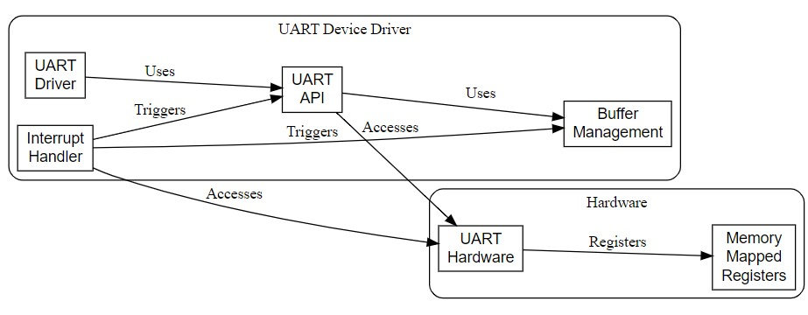
Functional block diagram relating input and output

